Slide 1
125khz HID Prox and RFID Prox Technology
By Ari Bornstein

Slide 2
Why Bother?
One key can get you entry to multiple doors without being a master key.
Allows for wireless access.
Can hold more data than a mag-stripe card or barcode.

Slide 3
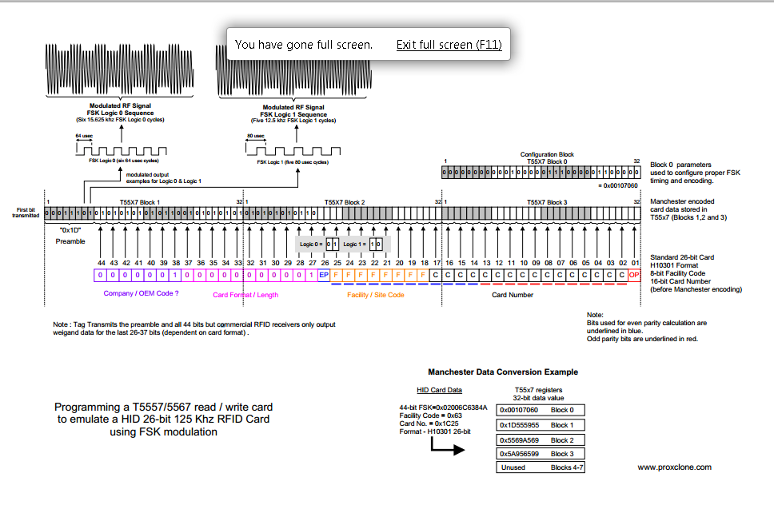
Protocol Stack
Formatting
Encoding
Interface
Hardware

Slide 4
Protocol And Parity

Slide 5
EM4100 40bit Parity Formating
Nibble A =X,X,X,X,P
Nibble B =X,X,X,X,P
Nibble C =X,X,X,X,P
Nibble D =X,X,X,X,P
Nibble E =X,X,X,X,P
Nibble F =X,X,X,X,P
Nibble G =X,X,X,X,P
Nibble H =X,X,X,X,P
Nibble I =X,X,X,X,P
Nibble J =X,X,X,X,P
End Parity P,P ,P,P, 0

Slide 6
Goucher HID 33Bit Parity Formating
1bit 7bits 24bits 1bit
X XXXXXXX XXXXXXXX|X|XXXXXXXXXXXXXXX X
EP FC Card Data OP

Slide 7
Encoding

Slide 8
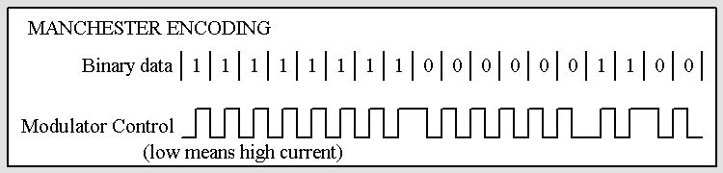
Manchester Encoding

Slide 9
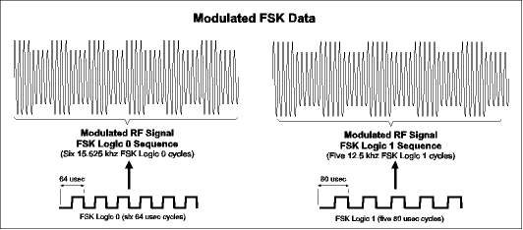
FSK Modulation

Slide 10
Interface

Slide 11
Wiegand Interface
The Wiegand interface uses three wires Common Ground, DATA0 and DATA1
When no data is being sent both DATA0 and DATA1 transmit +5 VDC.
When 0 is sent the DATA0 wire is decreased to a low voltage while the DATA1 wire stays at 5volts
When 1 is sent the DATA1 wire is pulled to a low voltage while DATA0 stays at a high voltage.

Slide 12
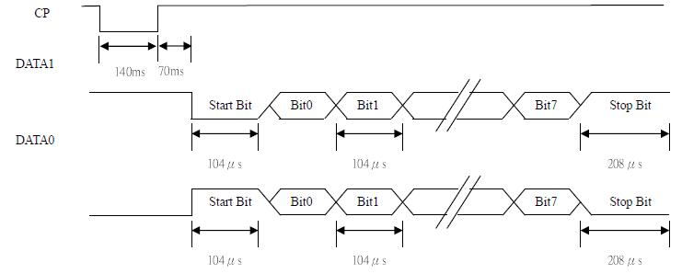
UART TTL Interface
Allows for One Input
Uses built in Clock in the UART

Slide 13
Hardware

Slide 14
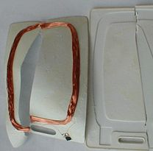
Passive Card
Composed of Coil, IC and Capacitor
The coil and capacitor absorb and store energy from the field.
This energy powers the integrated circuit.

Slide 15
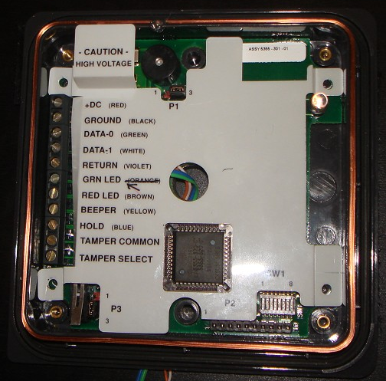
HID Prox Reader
Takes 10VDC+
Uses Wigand Interface
Does Built in Preprocessing

Slide 16
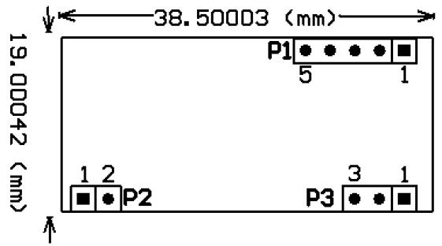
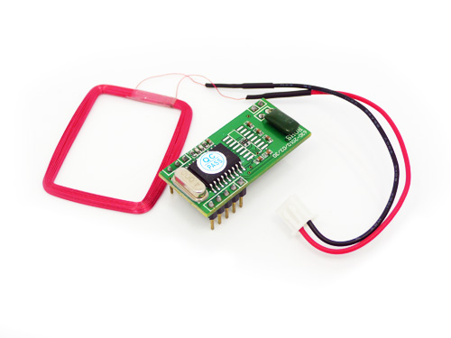
EM4100 Reader
Takes 5VDC+
Uses UART
Does Built in Preprocessing

Slide 17
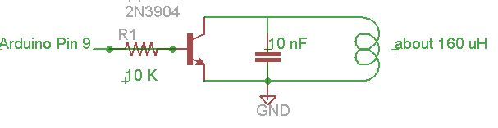
Active Spoofer

